Slide 1

Our brand playbook_
November 2023

Slide 2
Usage_
Presentations, fonts, accent & colour
Headings All headings should be set in Inter. Headings in presentations are encouraged to be set in Inter Normal but Inter Bold can be used also. Regardless of the weight the application should be consistent throughout.
Accent The green accent is a key feature of the brand and identity. It’s use is encouraged but purposefully.
We can use accents in headings, page breaks and in pull out statements in comms. The accent is part of the Inter font.
Fonts We have 2 fonts. ‘Inter’ as our primary font and ‘Bitter’ as our secondary, supporting font.
Inter should be the primary font used for presentations as text in sales and presentations are generally very short bulleted and more process based, with diagrams and methodologies being the main focus.
‘Bitter’ can be introduced in sections like About Nearform, Clients Testimonials and anywhere where emotive statements playout.
Colours We have four colours available within our palette. Our two hero colours are Midnight Navy and Green followed by our Purple and Blue.
Green is an intrical part of the new brand look and feel and it’s use with Midnight Navy is encouraged.
But due to the vibrancy of our green it has some contrast constraints when used as text.
Accessibility: Green on white or white on green text should not be used anywhere. This rule does not apply to icons, our accent or any other decorative applications.

Slide 3
Identity
in action_

Slide 4
Usage_ Logo
Usage of our mark
Do not stretch, warp or distort the logo. Please be mindful when scaling.
Do not outline the logo.
Do not change the colour of
the logo to anything other than what’s in the NearForm colour palette.
Do not use drop shadows or any other effect on the logo.
Do not use unofficial colours.
Do not extend the
cursor symbol.
The above rules also apply to our logo mark.

Slide 5

Introduction_

Slide 6
Our brand_
Introducing Nearform’s brand strategy and proposition
This playbook provides the framework, language and visual guidelines that will help all Nearformers understand and communicate our brand offering, and empower us to collectively create enduring value for the Nearform brand, growing our business.
Our goal for this playbook is to inspire all Nearformers to connect with and embody the Nearform brand - and our unique value offering.

Slide 7
The brand ambition_
We are adapting, evolving and growing.
So is our brand.
Nearform is moving from being a supplier, to being a partner for our clients.
We refined our brand strategy to enhance how we showcase the scope and impact of our client offering across product and design, platform engineering, and data-driven, AI-powered intelligent solutions, while emphasising how we empower clients by building digital capability for their teams.
Internally, this helps align us around a shared understanding of Nearform’s brand; our collective identity, our common purpose.

Slide 8
Brand
positioning_

Slide 9
Moving forwards_
We are Nearform.
For now, please read and consider this playbook carefully. Understand and explore what it is to be Nearform and how we now communicate who we are - and what we offer to clients. Particularly look at how we express the promise we make to be their partner in delivering intelligent digital solutions and our unique approach to achieving enduring value for their business.
We will launch the new visual identity and branding internally between 15th and 17th January 2024, and externally on 23rd January. Please continue to use our current branding until then.

Slide 10
Contents_
Brand positioning
Vision & mission
Company overview
Our story - video
Brand essence
Proposition
Outputs & outcomes
Core competitive advantage
Strategy on a page
Team
Clients
—
Voice & personality
Visual identity
Logo
Colourways
Logo symbol
Colour
Typography - fonts
Imagery
Dos & don’ts
Identity in action
Letter
Business Card
Email signature
Social media banner
Event roll up
Merchandise
Next steps
Launch timeline
Checklist
Resources

Slide 11
Our vision & mission_
Our destination and how we will get there
Our vision
A world that is digitally empowered to accelerate and sustain progress.
Our Mission
We design and develop empowering digital solutions
while nurturing a business that
attracts, inspires, and grows exceptional talent.

Slide 12
Company overview_
Nearform is an independent team of engineers, designers and strategists who build digital capability and intelligent software solutions for ambitious enterprises seeking sustained business impact.
We define, design and build platforms and enterprise systems that bring together people, process and technology to modernise organisations. Our innovative, resilient solutions empower clients and their teams to deploy faster, scale easier, and move forward with confidence.
Through a combination of expertly crafted code, enhanced capability and collaboration, we enable our clients to deliver great customer experiences and enduring business value.
Nearform is powered by a passionate team in 34 countries, and is trusted by large enterprise clients including Condé Nast, Charles River Laboratories, Lululemon, LEGO, Puma, TELUS, The Atlantic, Virgin Media 02, and Walmart.

Slide 13
Our story_
Code, Capability and Collaboration
Notes:
Note: Our story captures the energy and passion of Nearform — recognising our provenance in code, Open Source and engineering excellence. But while what we do drives us, we are also driven by the sustained impact we deliver for our clients, our community, and the world.

Slide 14
Brand essence_
Independent
Perspective
Independent Perspective_ We bring an independent perspective when partnering with our clients. We share their ambition while challenging assumptions to maximise impact.
Accelerated Process_ We build momentum by harnessing short-term and long term goals to create the conditions in which clients can move forward with confidence.
Sustained Impact_ By building great digital solutions and combining capability building we ensure that the positive impact we achieve is sustained.
Sustained
Impact
Accelerated
Process

Slide 15
Brand essence_
Independent
Perspective
Why_ We believe in the power of digital to
accelerate and sustain progress.
How_ We empower organisations through insight, imagination and expertly engineered solutions to accelerate and sustain progress.
Who_ We are an independent team of talented developers, designers, and strategists — passionate about accelerating and sustaining progress with forward-looking clients.
Sustained
Impact
Accelerated
Process

Slide 16
Our Proposition_ The promise we make to our clients
We combine engineering, design, and strategy to build digital solutions and capability for enduring impact.
More detailed version:
We are an independent team of engineers, designers and strategists who build digital solutions and capability at pace for ambitious enterprises seeking enduring business impact.
More succinct version:
We build digital solutions and capability at pace for enduring impact.

Slide 17
Our Proposition_ Diagram
Note
Each of the three areas of expertise in our proposition can be unpacked in different ways and build on the three innovation requirements: feasibility, desirability, and viability.
—
The combination of these skills deliver digital products, platforms, and data solutions. When combined with our way of working this also builds capability for our clients, resulting in enduring impact.
Engineering
—
Technology
— Feasible
Digital Solutions
Enduring Impact
Digital
Design
—
People Factors
— Desirable
Strategy
—
Business
— Viability & Impact
Capability

Slide 18
Outputs & Outcomes_
Emphasising the outcome and impact of what we do
Outputs
Product solutions that |  |  | Modern platforms that |  |  | Data solutions that
accelerate growth |  |  | transform business |  |  | empower business |  |  | Enhanced capability to be better, faster and go further
We design, architect and engineer digital products that improve business outcomes and accelerate growth. |  |  | We transform complex legacy applications into fast, future-ready digital platforms for enterprise. |  |  | We build data-driven solutions that deliver real-time insights, empower businesses and solve business-critical challenges. |  |  | We grow our clients’ digital capability by delivering developer- empowering platforms and nurturing a high-performance culture.
Outcomes
When presenting our work we emphasise the benefit of what we do in the form of outcomes and outputs.

Slide 19
Our core competitive advantage_
Talented Experts_ |  |  | Collaborative Culture_ |  |  | Accelerated Process _ |  |  | Experience & Passion_
Providing independent high-value insight and strategic advice. Experience & expertise also ensure greater quality, productivity and speed of delivery. |  |  | Our collaborative approach supports capability building and raises the bar for client teams while nurturing a culture of innovation and sustained performance. |  |  | Our processes combine strategic insight and planning with practical action to accelerate software delivery – reducing time to market and supporting ongoing scalability with leaner teams. |  |  | We bring over a decade of industry-leading experience in remote delivery across multiple sectors — fueled by an enduring passion for our craft and the impact we deliver.

Slide 20
Strategy overview_
Proposition |  |  | We combine engineering, design, and strategy to build digital solutions and capability for enduring impact.
Outputs & Outcomes |  |  | Product solutions that accelerate growth |  |  | Modern Platforms that transform business |  |  | Data solutions that empower business |  |  | Capability to be better, faster & go further
 |  |  | We design, architect and engineer digital products that improve business outcomes and accelerate growth. |  |  | We transform complex legacy applications into fast, future-ready digital platforms for enterprise. |  |  | We build data-driven solutions that deliver real-time insights, empower businesses and solve business-critical challenges. |  |  | We grow our clients’ digital capability by delivering developer-empowering platforms and by nurturing a high-performance culture.
Competitive Advantage |  |  | Talented Experts |  |  | Collaborative Culture |  |  | Accelerated Process |  |  | Experience & Passion
Vision & Mission |  |  | Our vision A world that is digitally empowered to accelerate and sustain progress. |  |  |  |  |  | Our mission We design and develop empowering digital solutions while nurturing a business that attracts, inspires, and grows exceptional talent.

Slide 21
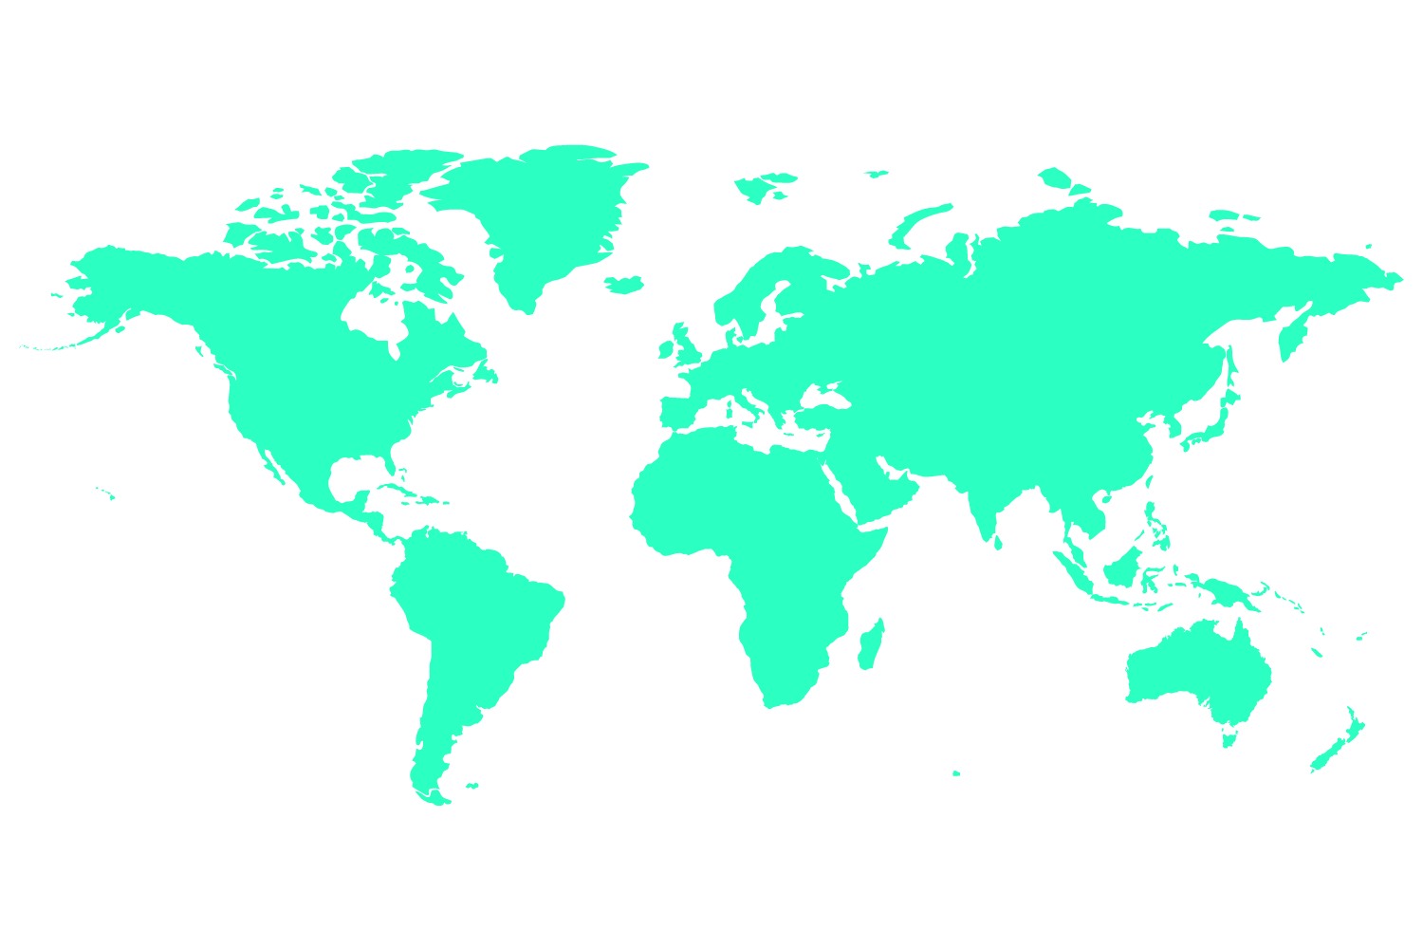
Team_
We’re are an independent team of engineers, designers and strategists who build digital solutions and enhanced capability at pace for ambitious enterprises seeking enduring business impact.
N_
N_
10+ Years experience
400+ Nearformers
30+ Countries
700+ Engagements 380+ Customers

Slide 22

















Clients_

Slide 23
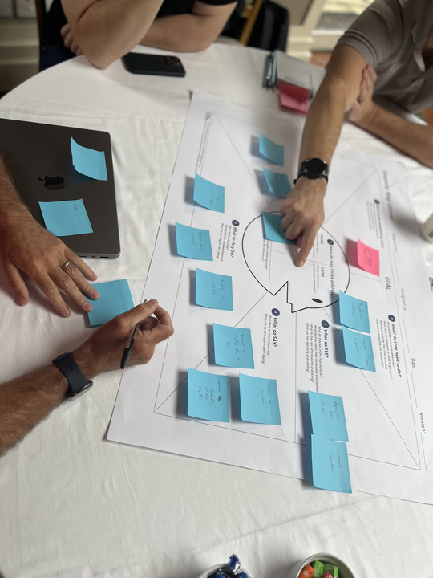
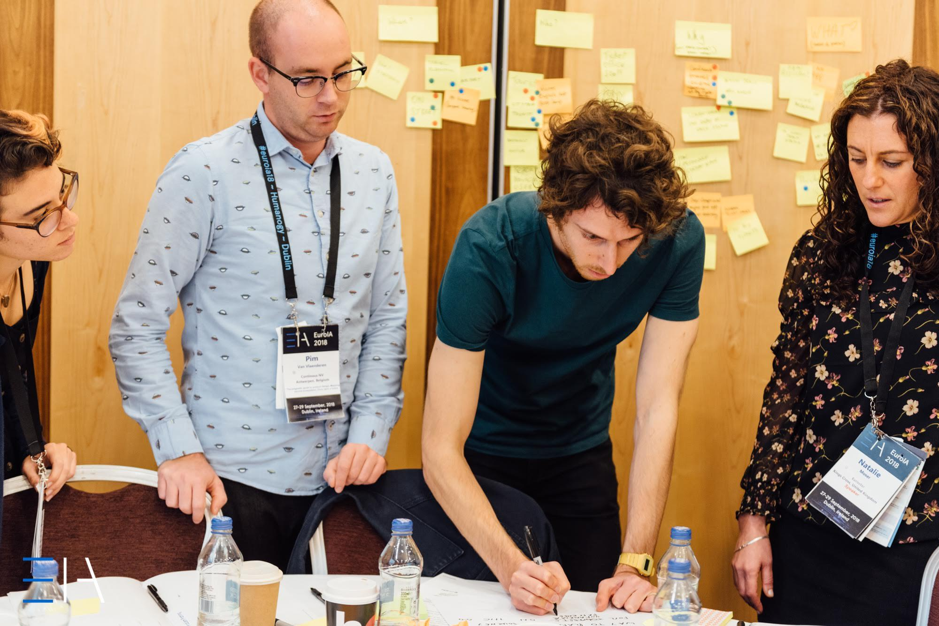
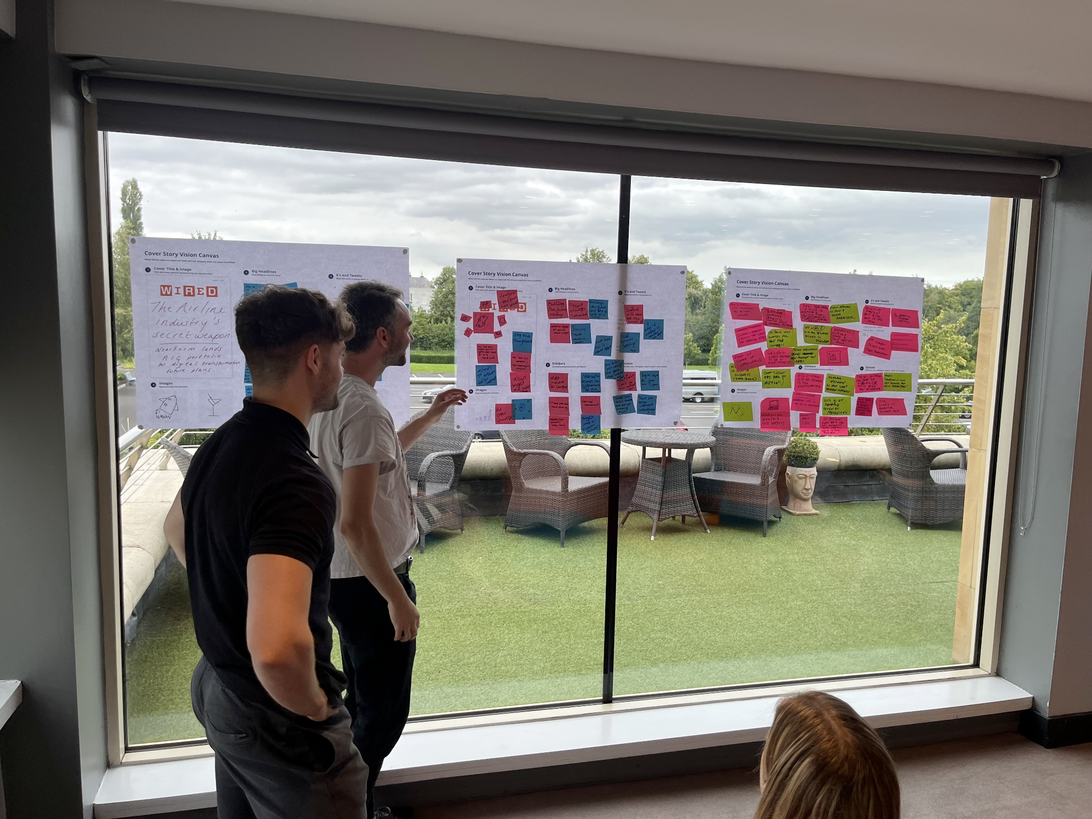
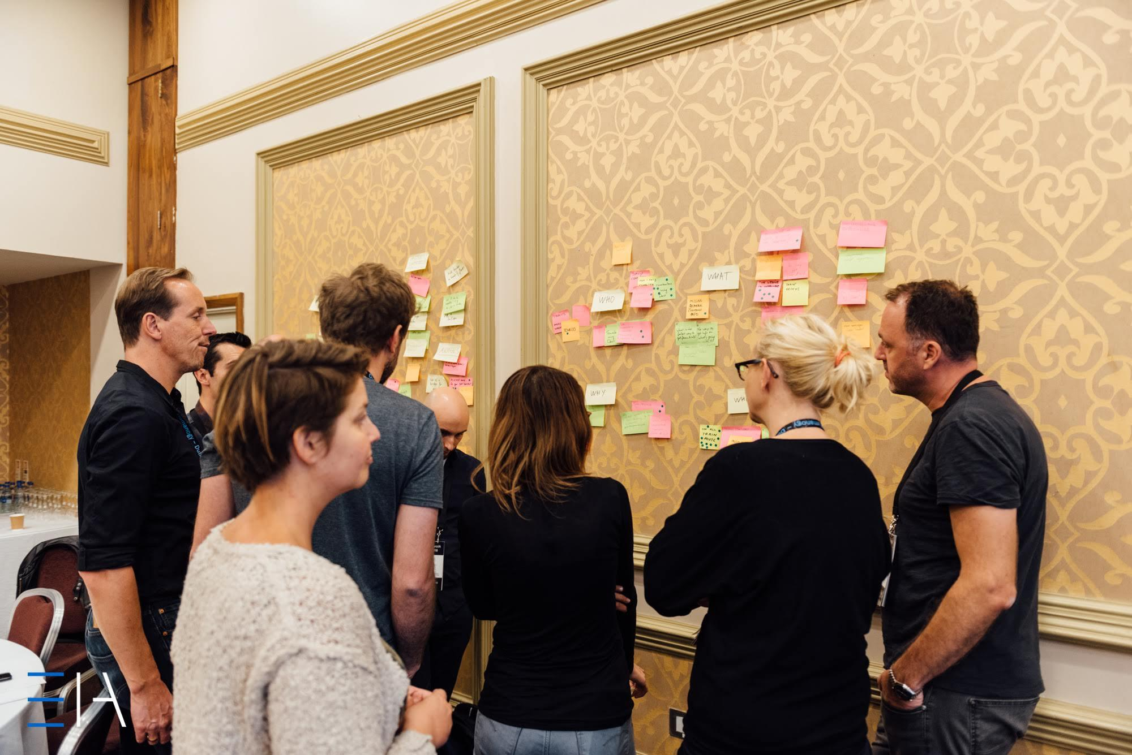
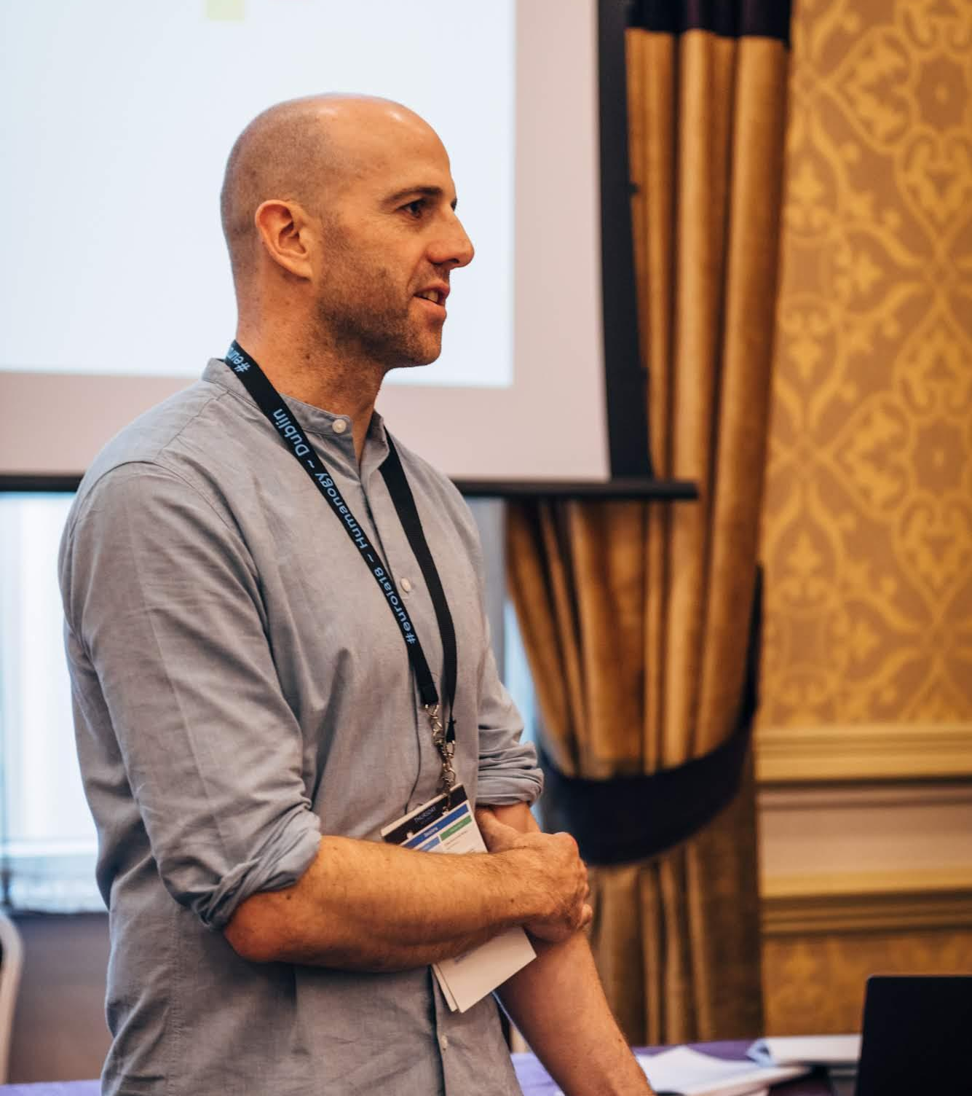
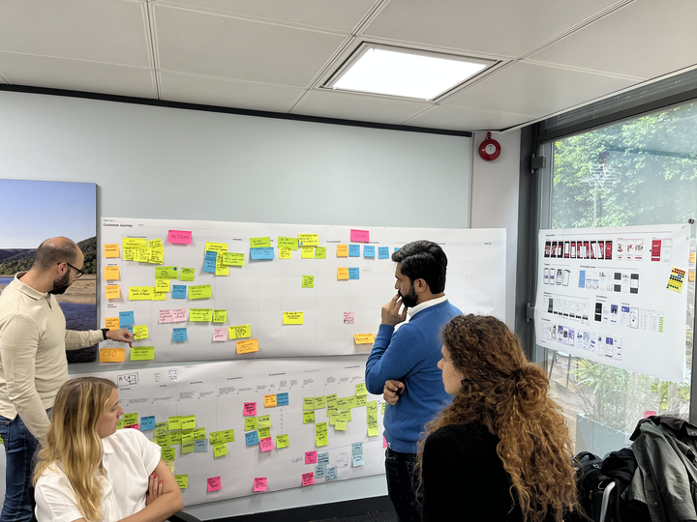
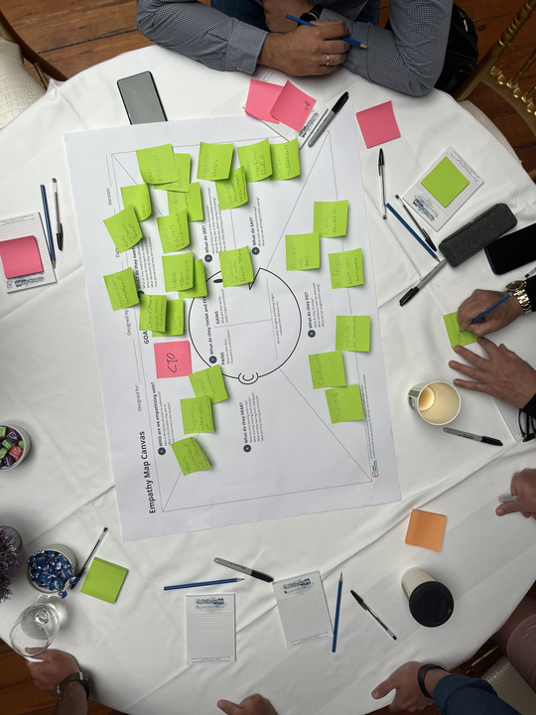

Slide 24
Tone of
voice_

Slide 25
Voice & personality_
Personality is not simply a set of adjectives… it’s an image created in our audience's mind based on a pattern of behaviour that we display. If we create content by following the six considerations listed here, we will create a consistent brand voice regardless of the personality of the person writing specific content.
Intelligent We are experts in our field and are generous with our knowledge and skill.
Action-oriented We are active and practical people who are energised by putting our imagination, insights and expertise to work.
Visionary We are focused on where we are going rather than just what we’re doing — we can see things that others can yet see and communicate and act in a manner that gives others the confidence to join us on the journey.
Personal/Human What we do is a human endeavour — and we connect with others in a manner that empowers them as people to use digital technologies to achieve their goals. Personal connection and collaboration are essential in achieving this.
Independent We bring a distinct perspective to our work. We can enter a respectful and mutually beneficial conversation and collaboration by sharing that perspective. It is our individual differences that make us such a great team.

Slide 26
General principles to keep in mind_
Drive to communicate outcomes over outputs.
— Frame Nearform as a partner, not as a supplier.
— Use the contents of this presentation as a framework, not a script.
—
‹#›

Slide 27
Visual
identity_

Slide 28

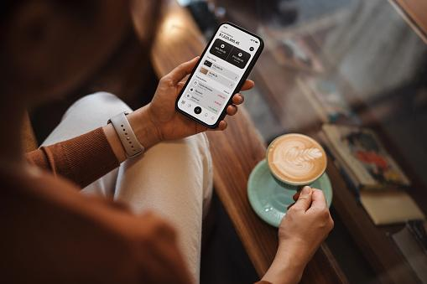




Identity components_
Our visual identity comprises a set of visual building blocks. These can be combined in an infinite number of ways to create communications that are coherent across all touchpoints.
Logo
Symbol
Imagery
Typography
Colour
Abc
Abc

Slide 29
Logo_
Our logo is a clear, geometric wordmark of our distinctive name.
The simple forms of our letters are presented as a single word — featuring a unique ligature between the ‘r & f’ at its centre.
The ‘cursor’ underscore at the end reflects our expertise in code and acts as an open symbol of possibility and connection.
Our logo is the core identifier for for our brand.
All logo types will be available for download along with new brand templates and assets from early Jan 2024.

Slide 30
Logo_
Our logo is a clear, geometric wordmark of our distinctive name.
The simple forms of our letters are presented as a single word — featuring a unique ligature between the ‘r & f’ at its centre.
Nearform is followed by a cursor underscore. Hinting at this idea of continuity; nodding to the origin of the Nearform name; something which is not yet done, unending, limitless - the possibilities presented to us by engineering, design and technology.
We pay homage to our open source code ancestry through the use of this underscore symbol, a playful tool that appears across our brand.
Our logo is the core identifier for for our brand.

Slide 31
Logo_ colourways
The primary version of the logo is the 2 colour — Deep Navy and Green. This logo appears on white or light colour backgrounds.
Other colour versions are: 2 colour reverse — White and Green, which is used when the logo is appearing on the Deep Navy background.
Single colour Deep Navy and White versions are also available, when using the logo on other colour backgrounds or reversing out of imagery.
Primary — 2 Color
Logo
Reverse — 2 Color
1 Color — Deep Navy
1 Color — White
Code

Slide 32




Logo_ on image backgrounds
When the logo is appearing on an image background, always ensure there is sufficient contrast for the logo to be clearly legible.
On darker image backgrounds the ‘cursor’ can appear in Nearfrom Green, adding an accent of colour.
Where the image or background is too busy, or lighter in tone — the single colour white logo should be used.
Code

Slide 33
Logo_ symbol
The compact symbol version of our logo comprises of the N with the ‘cursor’ underscore.
This version can be used as our avatar across social channels, and as a compact branding device on presentation pages.
The symbol version of the logo is available in all the same colour formats as the full logo wordmark.
2 Colour
Logo
Reverse — Dark
Reverse — Green
1 Colour — White

Slide 34

Logo_ animation
A simple logo animation revealing our name through code.

Slide 35

Colour palette_
Our primary palette
Our accents
Grey tones
Green
—
RGB 0, 229, 164
HEX #00E5A4
PMS 2240
Midnight
—
RGB 0, 14, 56
#000E38
PMS 289
CMYK 100, 65, 45, 50
Green —
RGB 0, 229, 164
HEX #00E5A4
PMS 2240
CMYK 85, 0, 55, 0
Purple
—
RGB 137, 80, 255
HEX #8950FF
PMS 2665
CMYK 68, 70, 0, 0
Blue
—
RGB 22, 107, 255
HEX #166bff
PMS 2727
CMYK 78, 48, 0, 0
Nearform Deep Navy, Green and White are the main colours of our brand identity.
Blue and Purple are used as accent colours and Light Blue, Purple, Navy and Grey are used to create low-contrast backgrounds within our website.
Midnight 80
#0C3D60
Green 80
#33EAAE
Purple 80
#A173FF
Blue 80
#4589FF
Grey 10
—
RGB 69, 137, 255
HEX #EAEBED
ASE Files Our colour palettes as .ASE files for import into design programmes will be released along with new brand templates (Jan 2024).
Midnight 50
#526288
Green 50
#78EEC5
Purple 50
#C4A7FF
Blue 50
#8AB5FF
Midnight 30
#97A1B8
Green 30
#B2F7E1
Purple 30
#DCCAFF
Blue 30
#B9D3FF
Grey 30
#D9D9D9
Midnight 10
#F4F8FA
Green 10
#E5FCF5
Purple 10
#F3EDFF
Blue 10
#E8F0FF
Grey 80
#454551

Slide 36
Typography_
Bitter
Our supporting typeface is Bitter – a serif typeface which works as a partner to our primary typeface Inter.
This serif typeface (Bitter) is used to set body copy and pull-quotes, adding texture and character to our communications.
We use a limited number of weights in application — driving for contrast through size and layout.
Bitter
Bitter Weights
We empower organisations through insight, imagination and expertly engineered solutions for enduring business impact.
We craft enterprise software solutions that deliver sustained value for your business, your customers and your future.
Light
Normal / Regular
Bold
Extra Bold
This typeface is open source and can be downloaded for use when the new brand templates are released (Jan 2024).

Slide 37
Typography_
Inter
Our primary typeface for communications is Inter — a variable font family carefully crafted & designed for computer screens. It features a tall x-height to aid in readability of mixed-case and lower-case text. Inter is used for all headings. It can also be used for body copy, and technical information.
Small captions are set in Inter to ensure legibility.
We use a limited number of weights in application — driving for contrast through size and layout.
Inter
Inter Weights
Building
enduring
impact_
Light
Normal / Regular
Bold
Black
This typeface is open source and can be downloaded for use when the new brand templates are released (Jan 2024).

Slide 38
Typography_ Hierarchy
Creating a clear hierarchy within layouts, gives impact and clarity:
Clean contemporary appearance through the use of range left typography.
Text is set in sentence case.
Simple information hierarchy is achieved through the use of scale and font mix.
The line length and line spacing facilitates easy reading.
Large titles
Inter — Normal (Regular)
96 — 140pt
Shaping digital futures_
Main headings
Inter — Normal (Regular)
36 — 48pt
Simplicity first.
Then success.
Body copy
Bitter — Normal (Regular)
20 — 28pt
As an independent digital consultancy, we operate where engineering, design and strategy meet. Our expertise lets us cut through the complexity to build agile, intuitive and resilient systems that help businesses thrive. Simple.
Captions / Info
Inter — Normal (Regular)
16 — 18pt
We combine digital engineering, design and strategy to build code and capability for sustained business impact

Slide 39



Imagery_
Impact / scale
People / Interaction
Abstract / Concept
We will provide an album of imagery that helps us convey and communicate concepts, ideas and messaging. Here, you can see a selection of images and the corresponding messages they convey.
This will be available for use in slide decks when the new branding templates are released (Jan 2024).

Slide 40
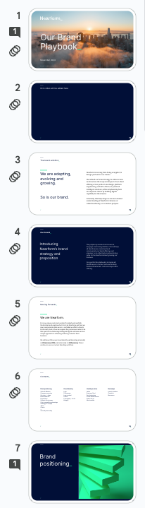
Usage_
Presentations dos and don’ts
Looks good
The dos Presentations slides, incl. reports, pitch documents or project updates are an important part of communicating with our colleagues and clients. These presentations should be formal and be presented clearly with minimal distraction of colour. Use light/white as your most prominent base colour for these documents with accent colours as visual supports for page breaks, diagrams and icons.
Slide templates will be released on 8th January.
The baseline colour is predominately white/light so the information is clear and readable
Imagery and colour help to differentiate the presentation without overwhelming the viewer
All headings are the same colour (dark on white or white on dark)a
Accent colours highlight sections of informations
The approx ratio of colour usage in doc.
70%
20%
5%
5%
White/light
Navy
Green
Purple

Slide 41
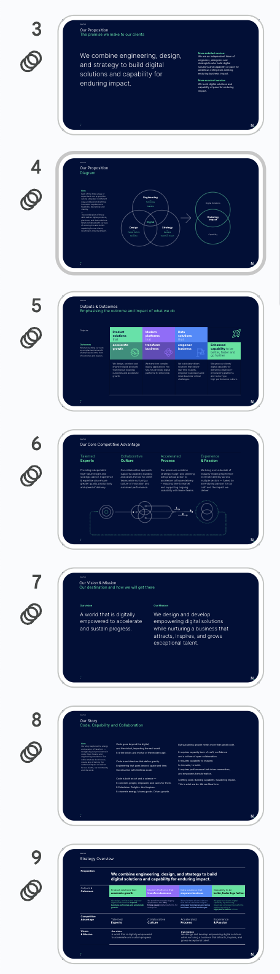
Usage_
Presentations dos and don’ts
Not so good.
The don’ts Don’t use 100% of Navy, Green or Purple for an entire document. Colour should only be used as a branding mechanic in touches, as page breakers or information indicators to highlight segments within the document - but selectively. Remember, the information is more important than the colour so try not to overcompensate.
Slide templates will be released on 8th January.
The base colour is entirely “dark mode” leaving for heavy reading.
Example image
TBC
The approx ratio of colour usage in doc.
20%
70%
5%
5%
White/light
Navy
Green
Purple

Slide 42
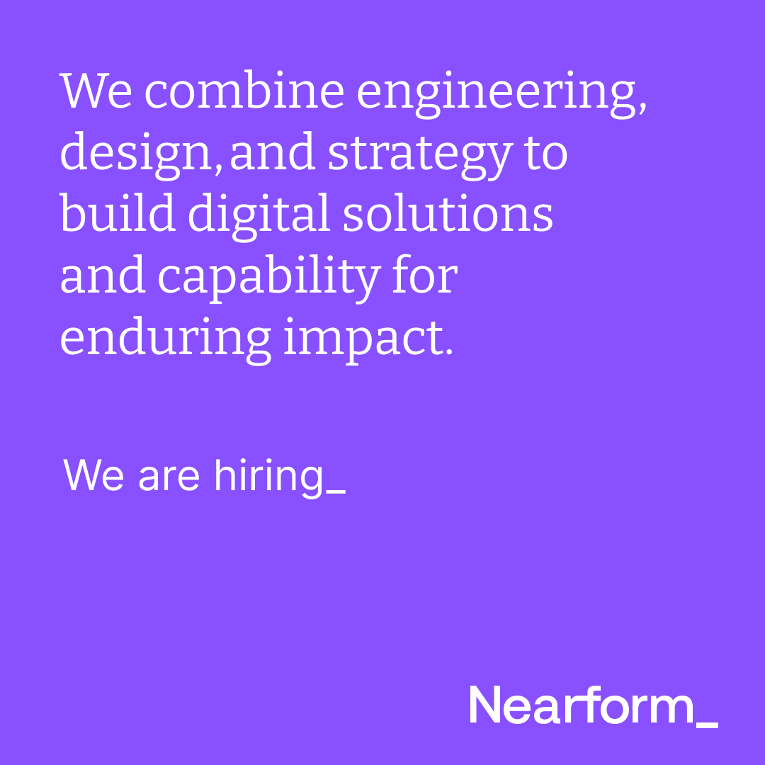
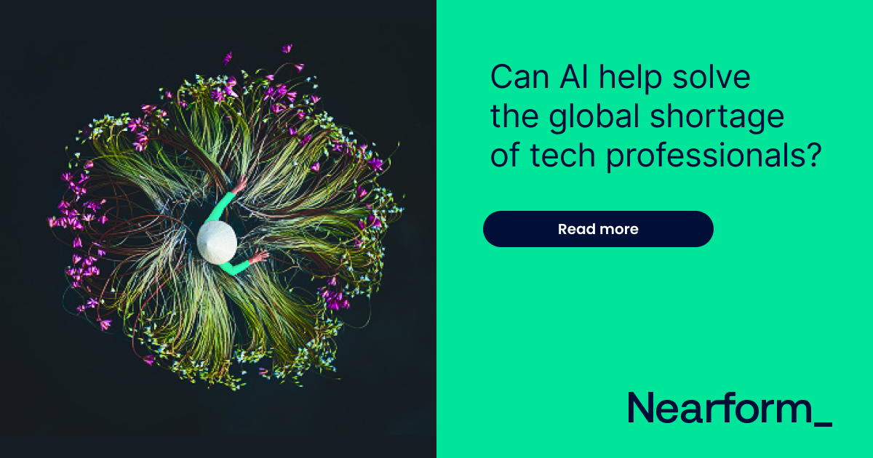

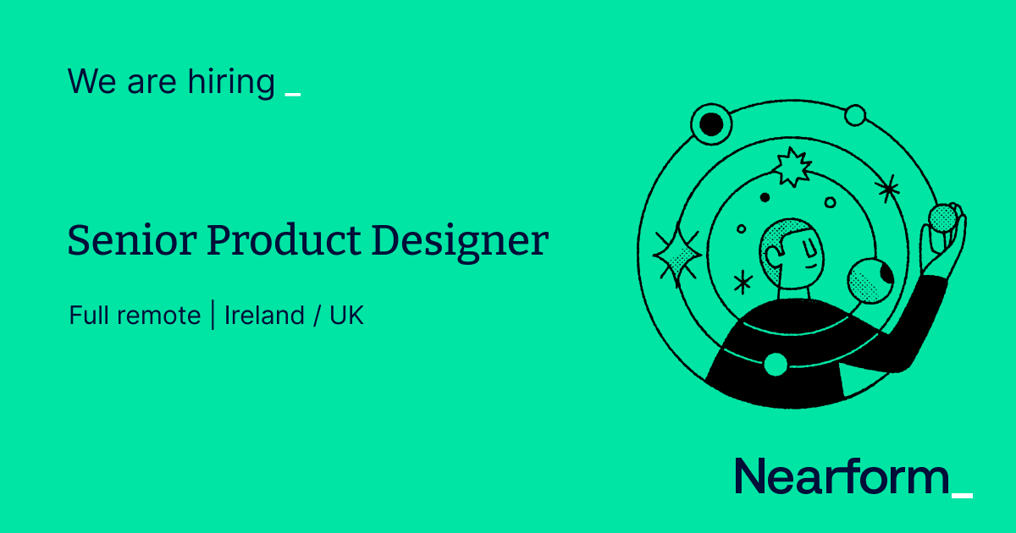

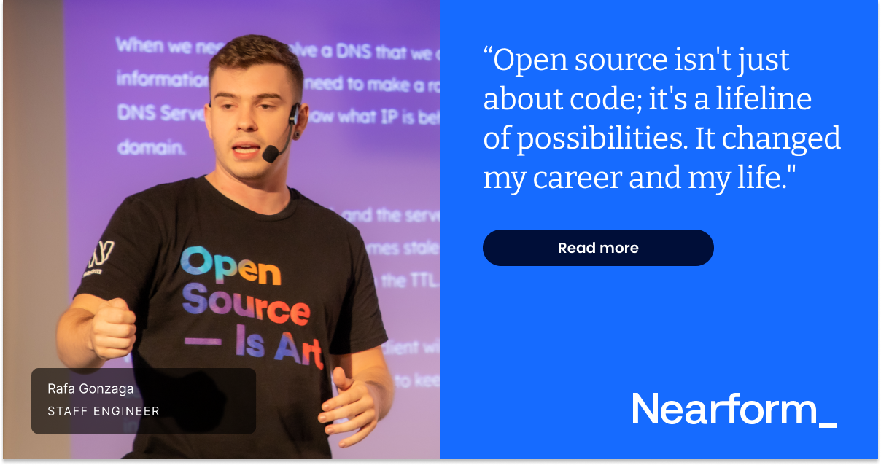
Digital & social_

Slide 43
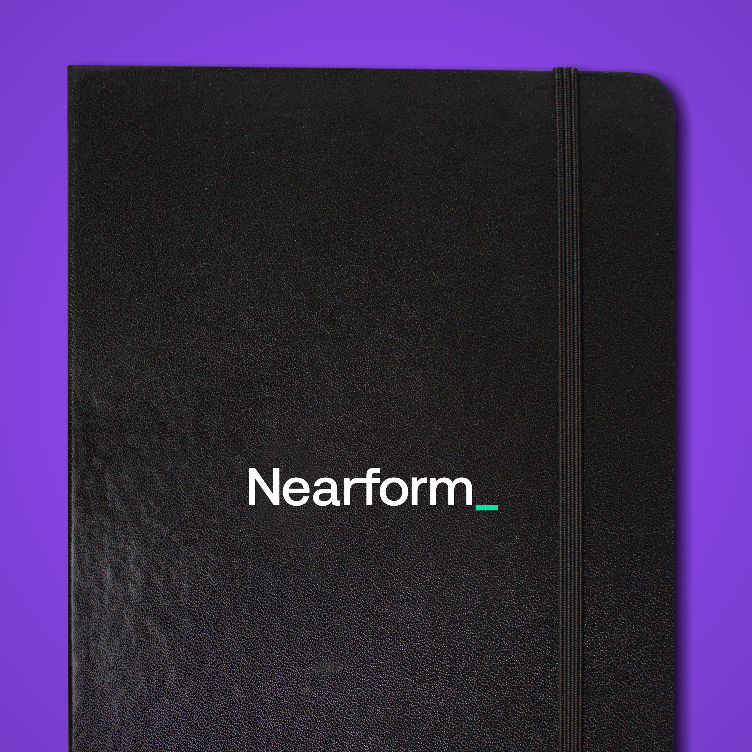
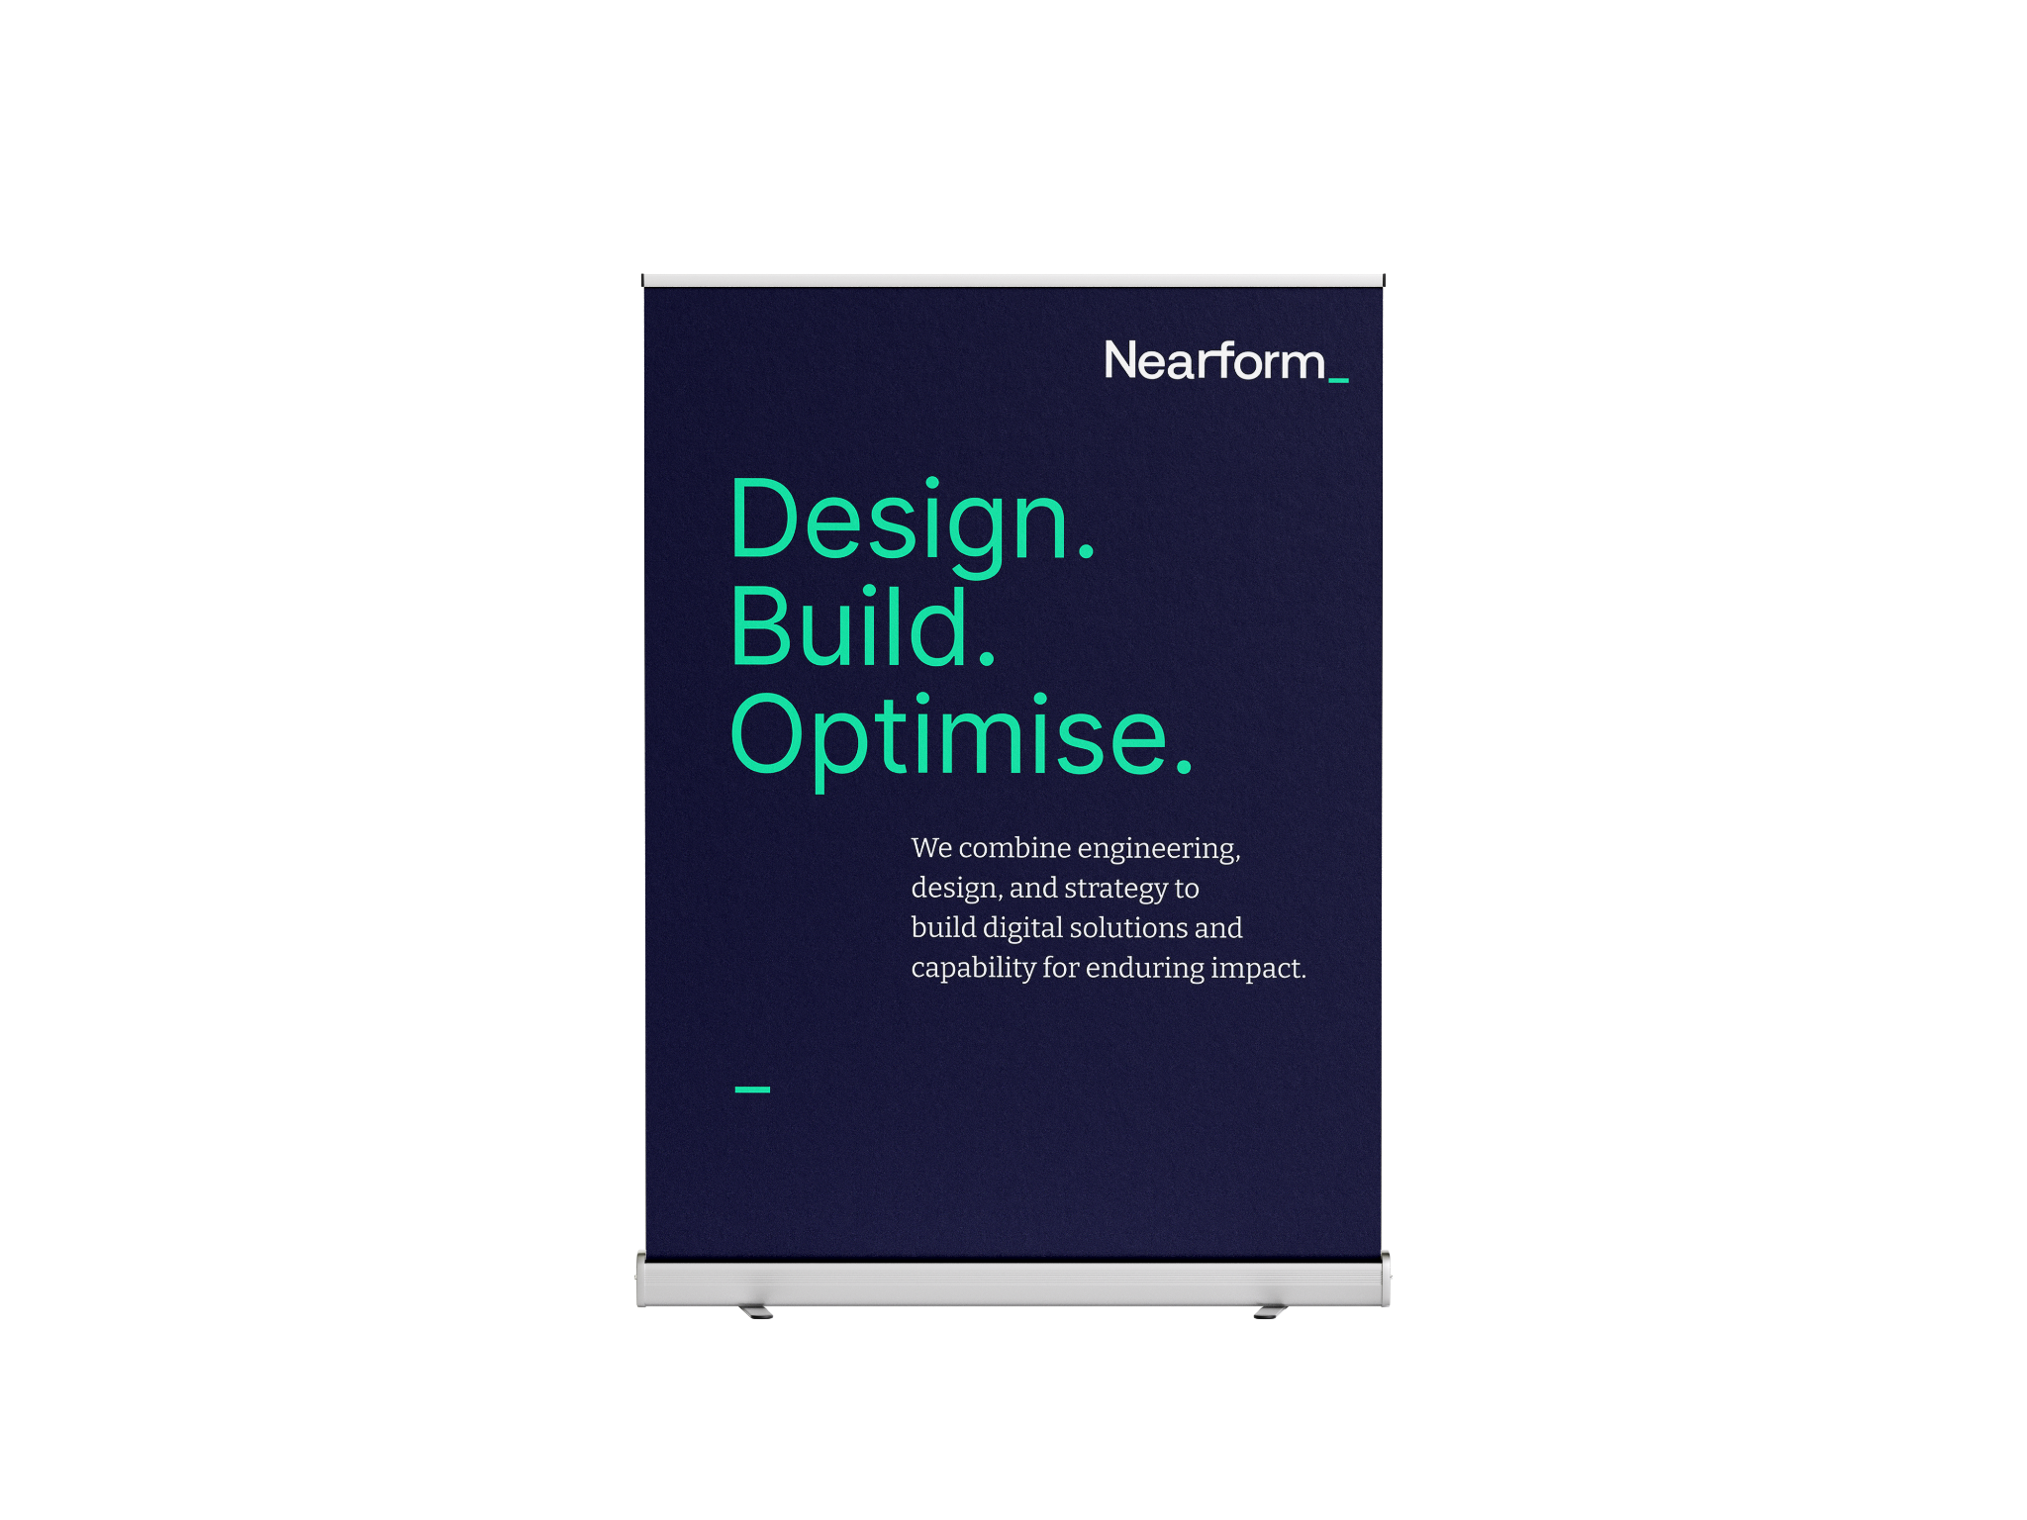
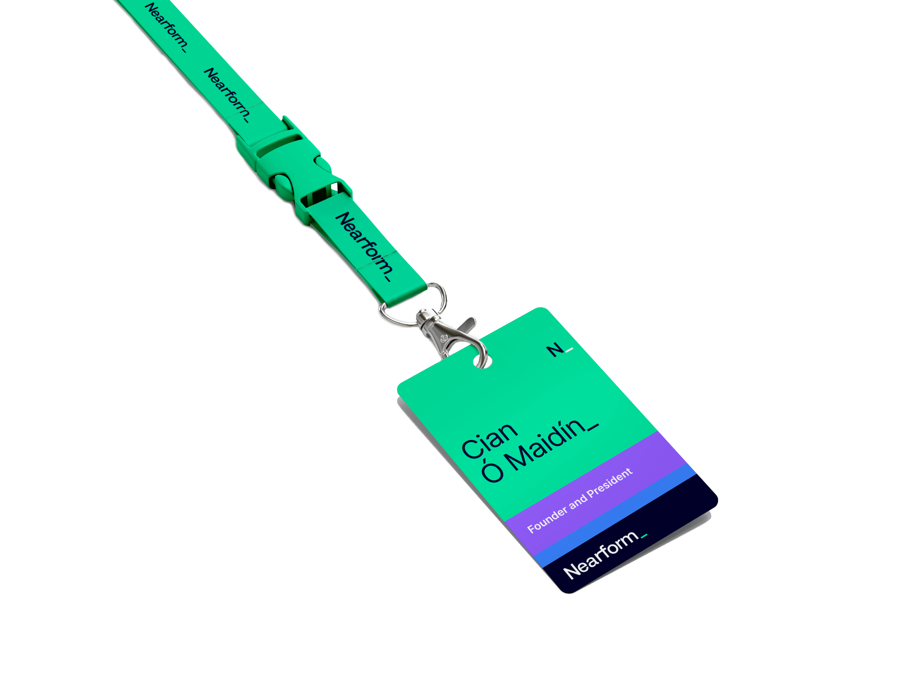
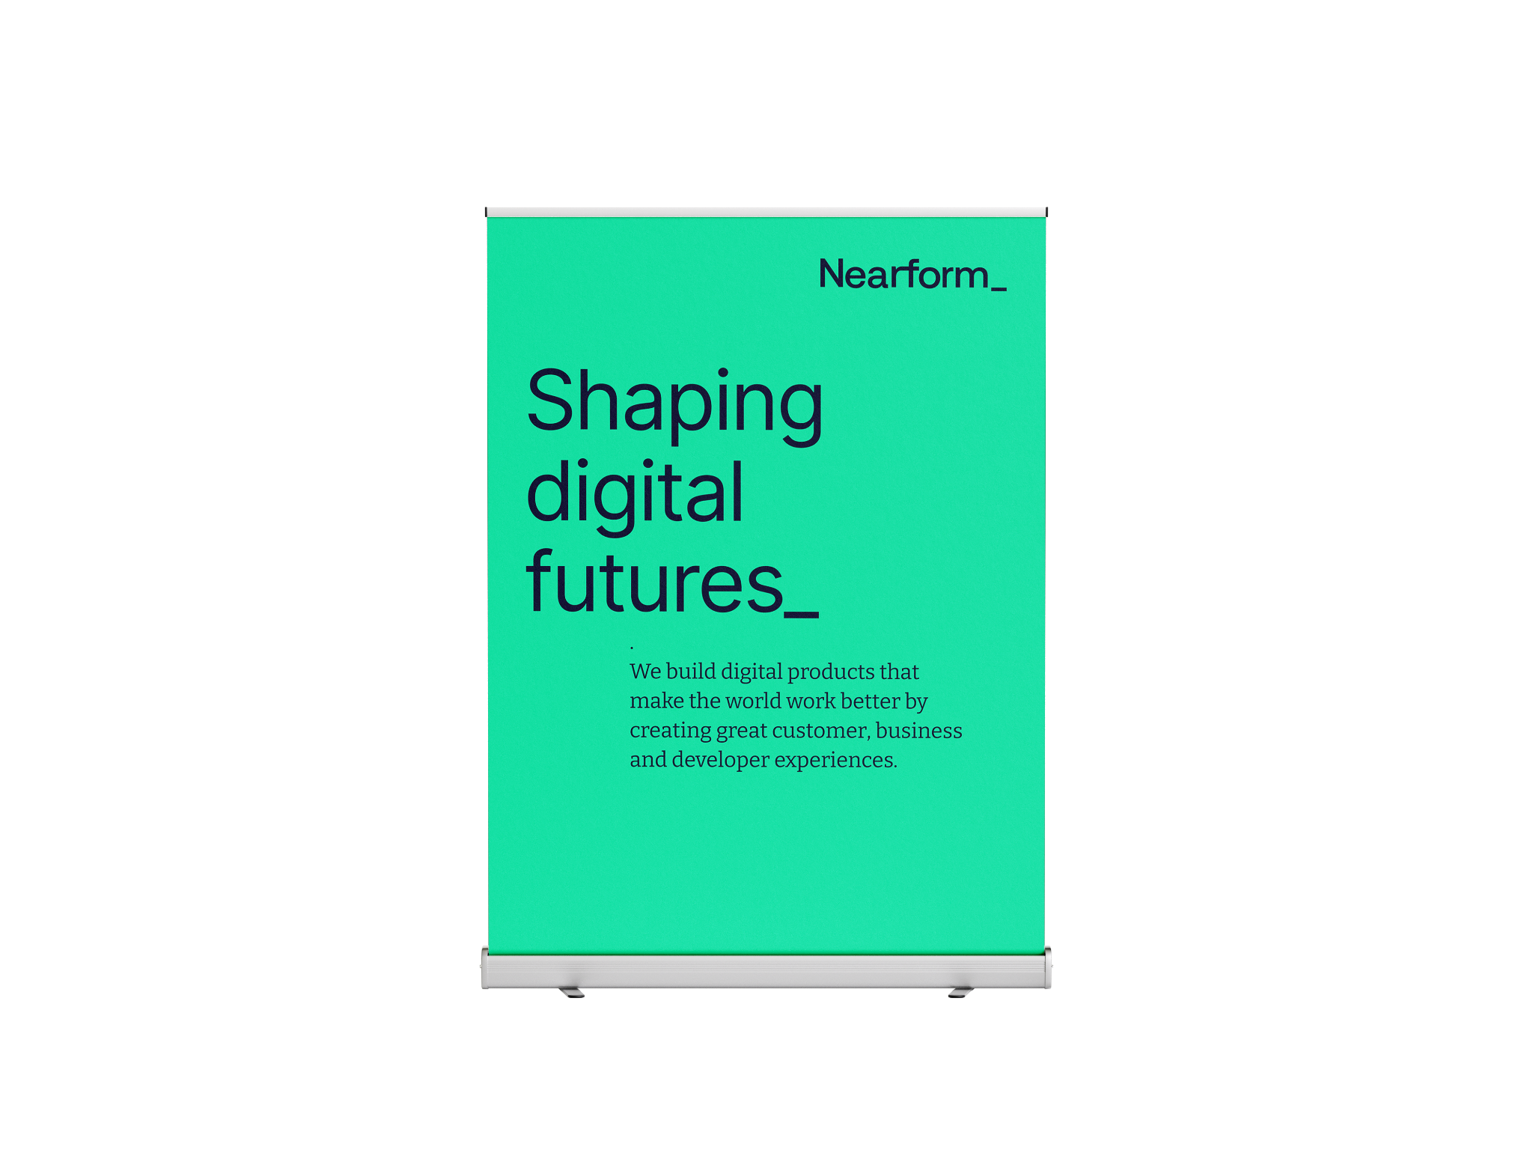
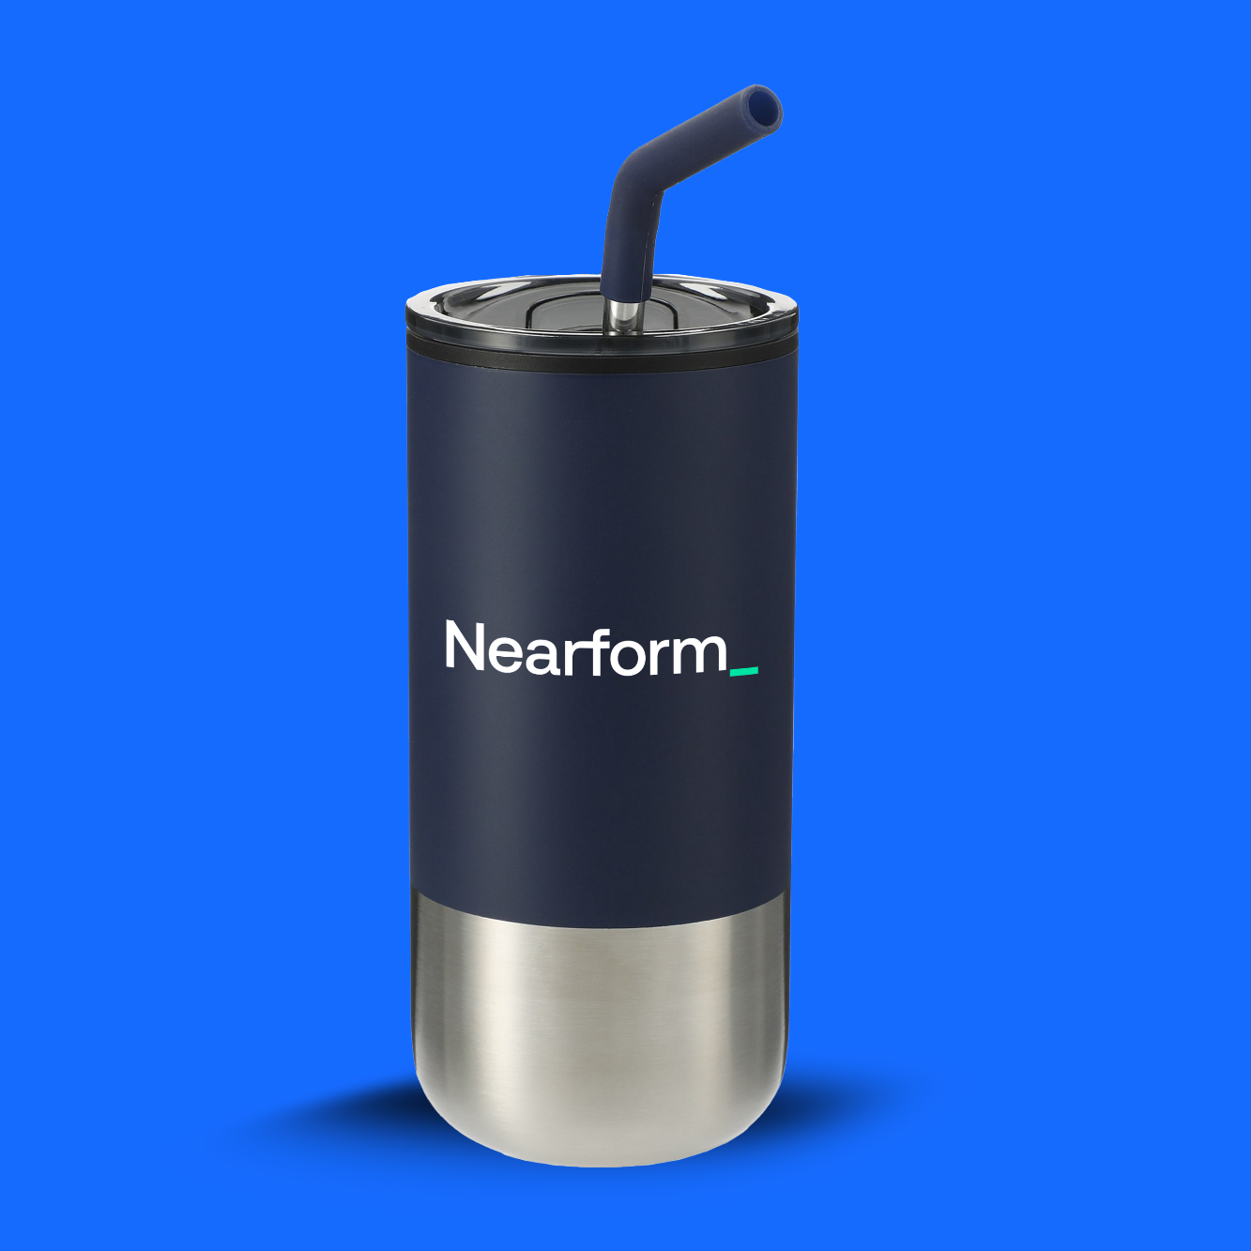
Events_

Slide 44
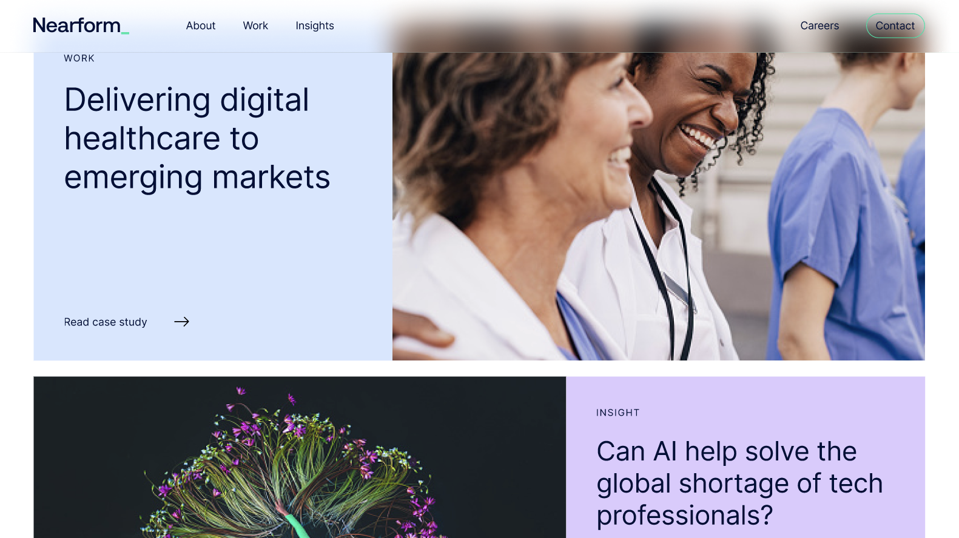
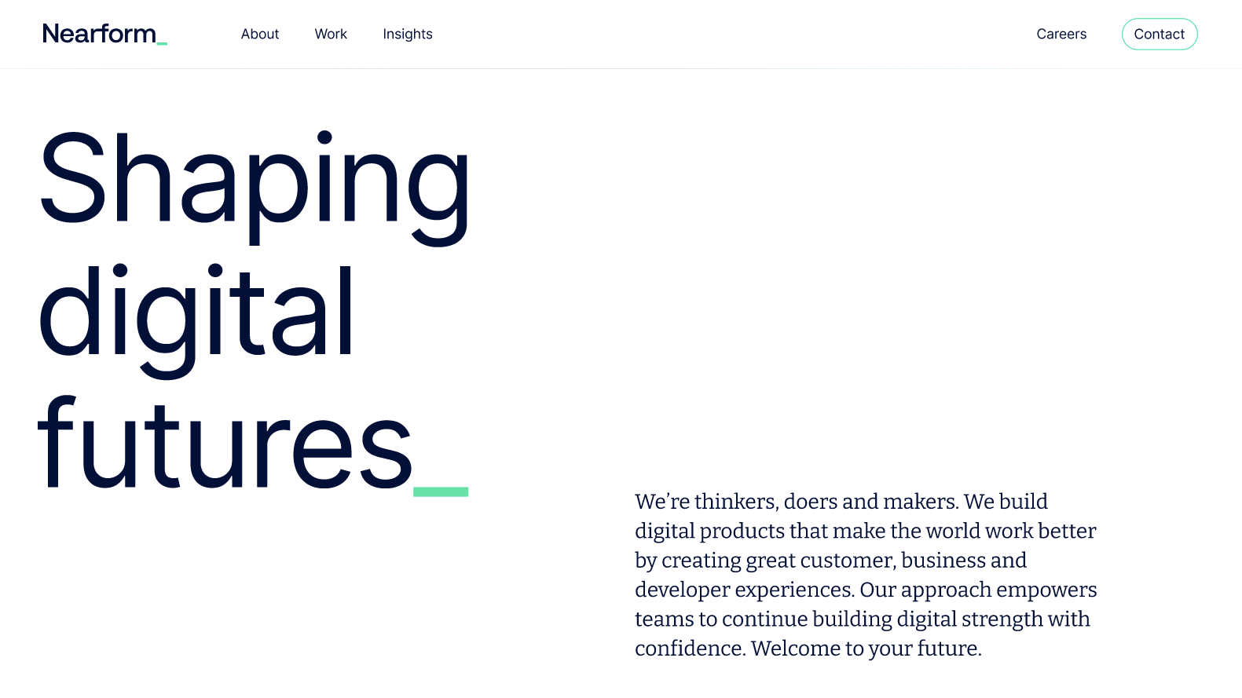
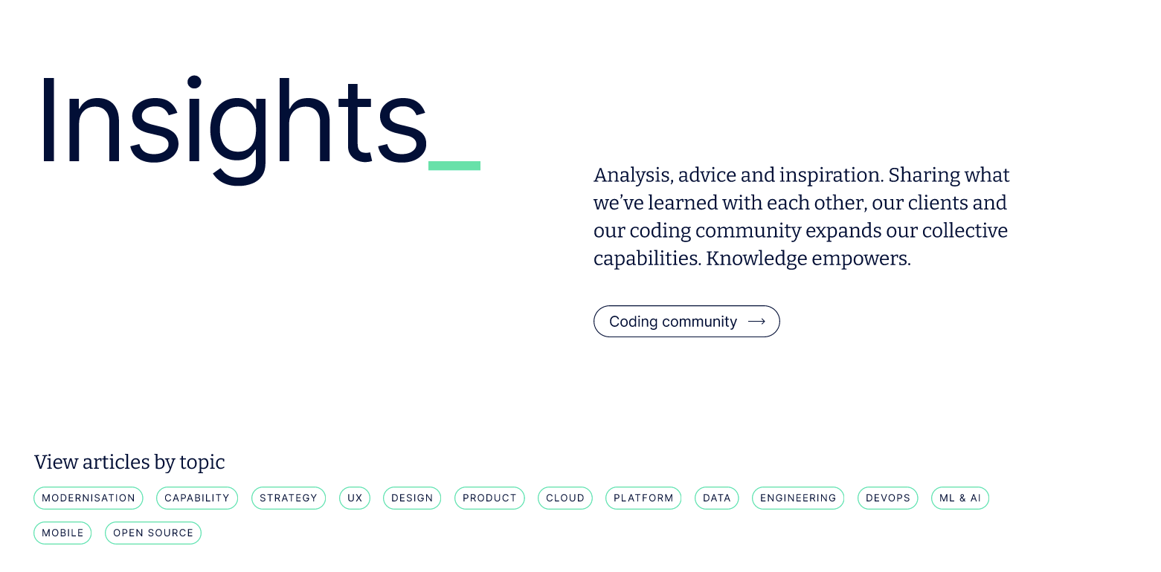
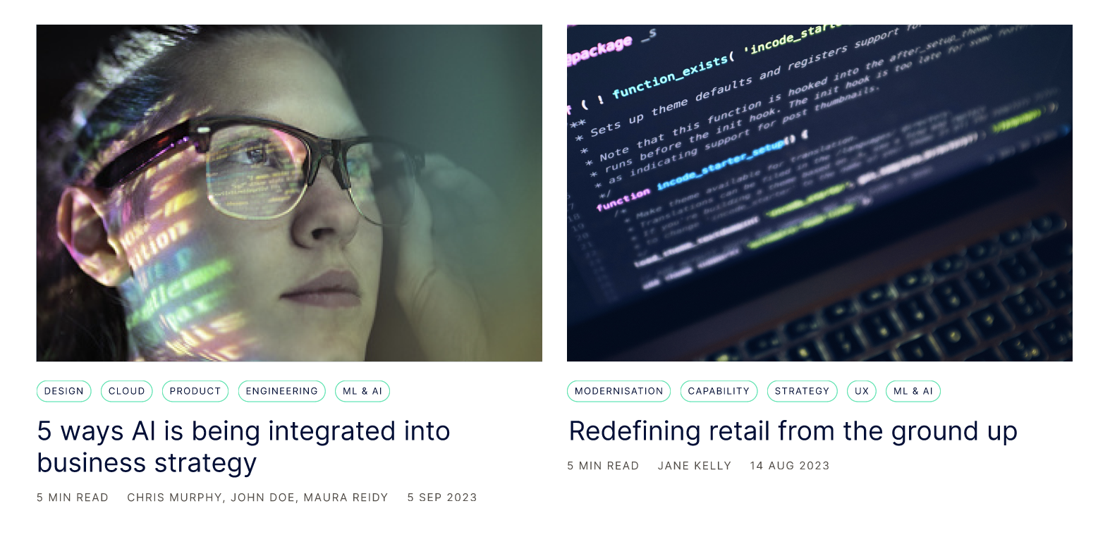
Website_

Slide 45



Nearform_Commerce
Positioning: Nearform_Commerce is a portfolio of our offerings in the Commerce & Composable Solution space; Nearform is committed to building digital solutions and capabilities, including for our commerce and retail clientele.
Microsite:
The Nearform_Commerce microsite serves to cater messaging specific to the requirements of retail & commerce enterprises. www.commerce.nearform.com
The typography, color palette and tone usage are the same as the hero Nearform brand.

Slide 46
Next
steps_

Slide 47
Timeline_
NOV | DEC | JAN Internal |  | JAN External |  | FEB Onwards
Audit and updating/rebranding of Nearform assets [docs, decks, marketing collateral]
Internal launch + sharing of guidelines, Leapsome module and next steps
Employees given access to new brand hub, templates and launch package
Changeover of all internal-facing branding; docs, templates, Leasome, Notion, etc.
Client and partner first look at brand proposition and new website; full launch across site, social and press
Changeover of all external-facing branding; social profiles, banners, email signatures, event collateral, etc.
Ongoing campaign to showcase positioning and messaging
Updating Assets
Launch & Communicate
Test & Refine
3rd Nov
Brand handover
Internal launch
Brand reveal; guidelines and Leapsome release
Leapsome deadline
All employees must complete mandatory Brand Positioning module by 17th Jan
External launch
Changeover of all external-facing brand assets and launch of new website on 30th Jan
Iterate
Development of messaging and brand assets where necessary

Slide 48
Thank you.

